Slide 1

Presentation of PIC Microcontroller
Question: How to design a circuit using PIC Microcontroller to control the stepper motor by generating following pattern:
1100 , 0110 , 0011, 1001
intro

Slide 2
Presentation of PIC Microcontroller
01
02
03
Question: How to design a circuit using PIC Microcontroller to control the stepper motor?
Naiha Rafiq
M.Waleed
Saleem Raza
contents
intro
BS ELE 5TH SEMESTER
BS ELE 5TH SEMESTER
BS ELE 5TH SEMESTER
For Introduction
For Explanation
For Programming and
Result

Slide 3




Presentation of PIC Microcontroller
What is PIC 18 and
What is Stepper motor
Types of modes of Unipolar
Question: How to design a circuit using PIC Microcontroller to control the stepper motor?
PIC 18
Applications of
Stepper motor
Motor diagram &
Circuit diagram
contents
about
Types of Stepper motor:
Unipolar and Bipolar
C programming
& Results

Slide 4
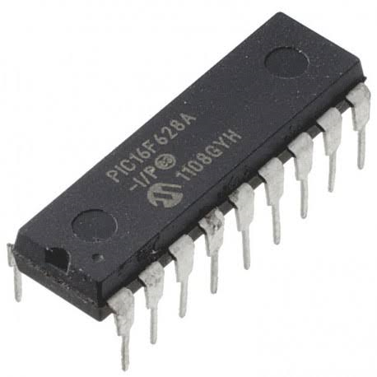
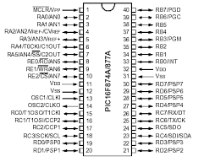
PIC microcontrollers are a family of specialized microcontroller
chips produced by Microchip Technology in Chandler, Arizona.
The acronym PIC stands for "peripheral interface controller."
A Typical microcontroller includes a processor, memory, and peripherals.
Presentation of PIC Microcontroller
Question: How to design a circuit using PIC Microcontroller to control the stepper motor?
history
PIC 18
Stepper motor
about

Slide 5
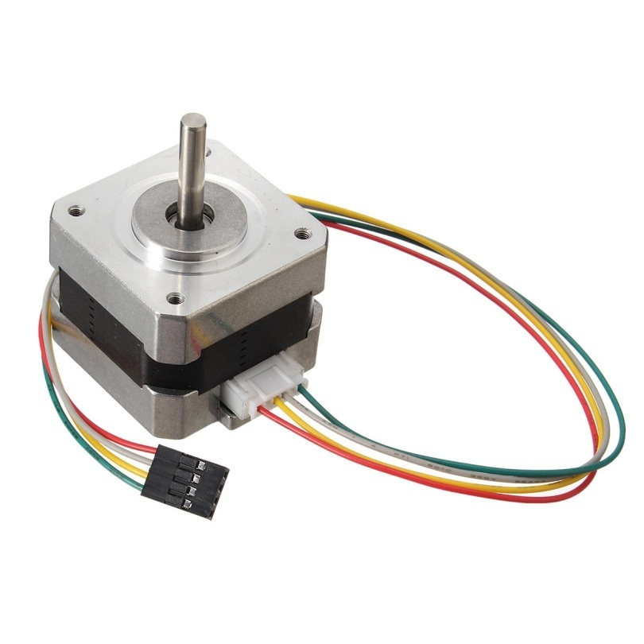

Presentation of PIC Microcontroller
Question: How to design a circuit using PIC Microcontroller to control the stepper motor?
Stepper motor
history
timeline
applications
about
Stepper motor
A stepper motor, also known as step motor or stepping motor, is a brushless DC electric motor that divides a full rotation into a number of discrete steps.

Slide 6

Presentation of PIC Microcontroller
Working of stepper motor:
Question: How to design a circuit using PIC Microcontroller to control the stepper motor?
The stepper motor uses the theory of operation for magnets to make the motor shaft turn a precise distance when a pulse of electricity is provided. The stator has eight poles, and the rotor has six poles. The rotor will require 24 pulses of electricity to move the 24 steps to make one complete revolution.
history
teams
timeline
applications
about
working

Slide 7

Presentation of PIC Microcontroller
Applications of stepper motor
Question: How to design a circuit using PIC Microcontroller to control the stepper motor?
stepper motors are used in:
floppy disk drives,
computer printers,
plotters,
slot machines,
image scanners,
compact disc drives,
and, more recently, in 3D printers.
history
services
teams
types
timeline
about
applications

Slide 8
Presentation of PIC Microcontroller
unipolar
bipolar
Question: How to design a circuit using PIC Microcontroller to control the stepper motor?
Further explanation
history
follow
services
teams
timeline
about
In the unipolar stepper motor which works with one winding with a center tap per phase, each section of the phase winding is turned on for each of the magnetic field direction. Since unipolar stepper motors are quite easy to operate, these are highly preferred among hobbyists.
types
In a bipolar stepper motor, there is a single winding per phase. This makes the driver circuit lot more complicated while reversing the magnetic poles which in turn reverses the current in the winding.

Slide 9
Presentation of PIC Microcontroller
Full step
Question: How to design a circuit using PIC Microcontroller to control the stepper motor?
In full step operation each step has a movement of 1.8 degrees and hence it takes 200 steps to complete a full revolution. This is made possible by energizing either single of stator winding or two phases. Since the two phases are energized at the same time in the dual phase operation, torque and speed are greater in this kind of operation while the single phase operation requires a lower amount of power from the driver circuit.
Further explanation
history
C diagram
follow
services
teams
timeline
about
about

Slide 10
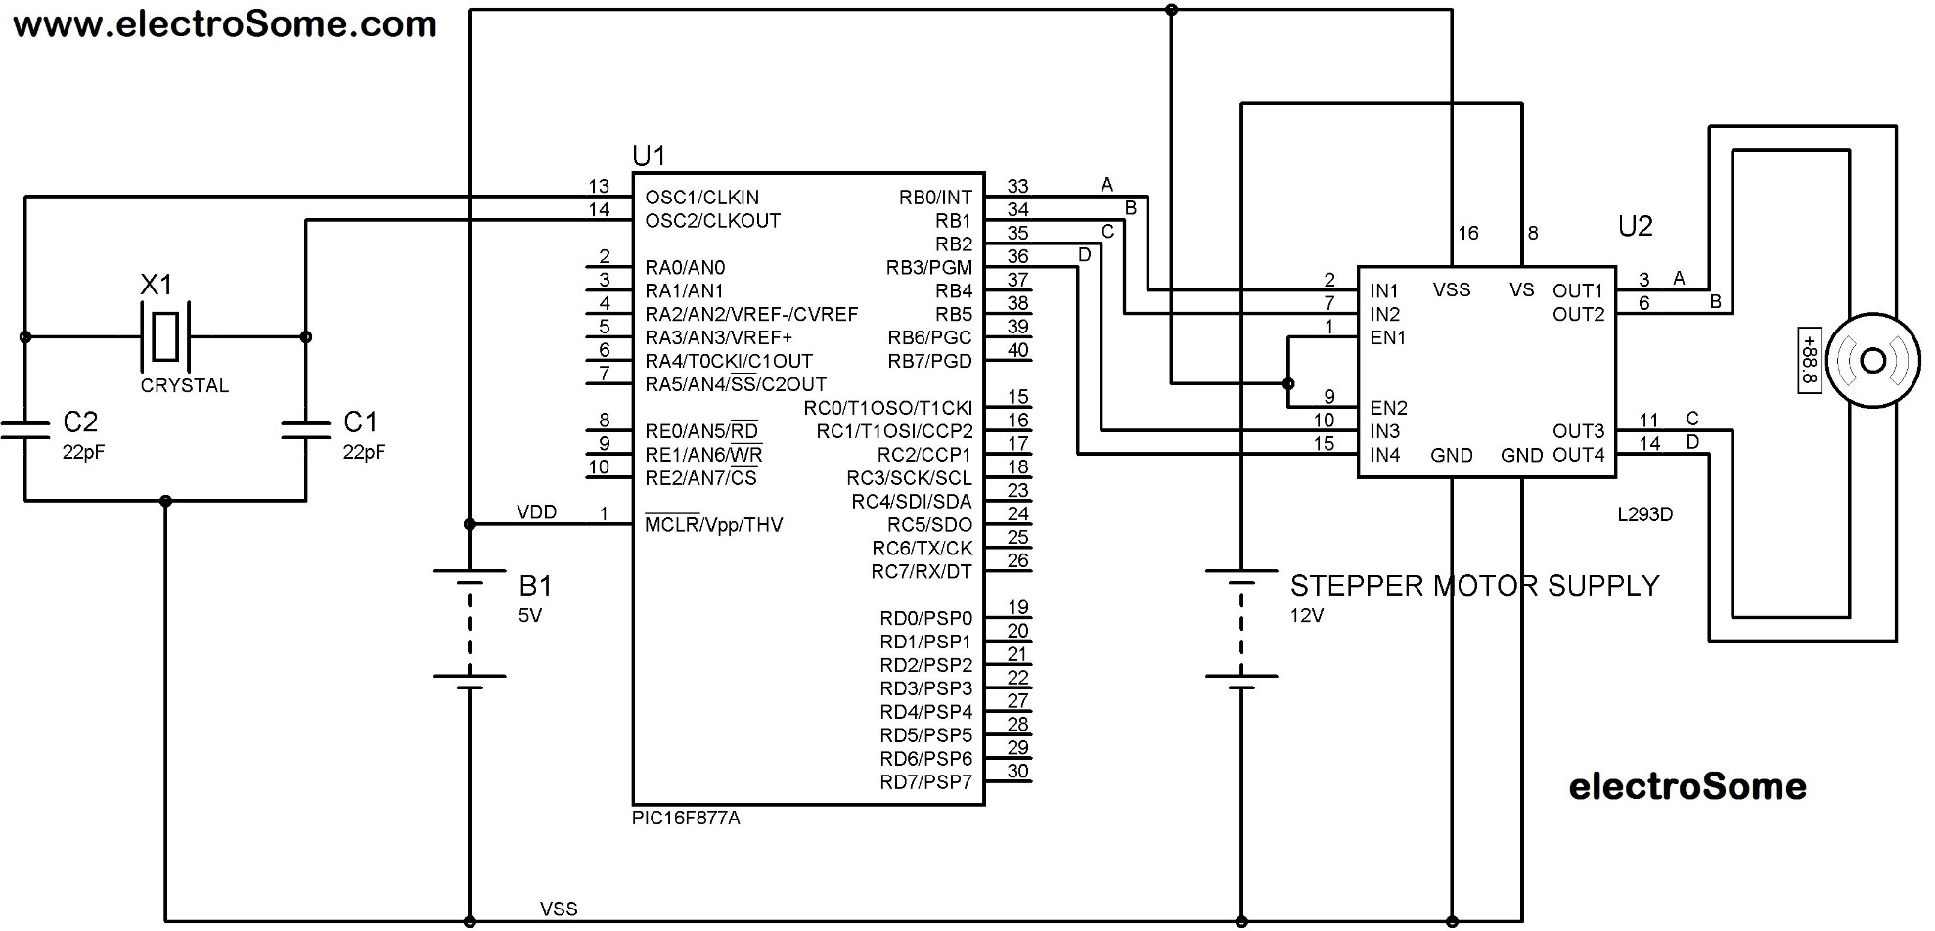
Presentation of PIC Microcontroller
Question: How to design a circuit using PIC Microcontroller to control the stepper motor?
history
C program
history
follow
services
teams
timeline
about
about
c. diagram

Slide 11
C Program:
#include<xc.h>
#define PC0 PORTCbits.RC0
#define PC1 PORTCbits.RC1
#define PC2 PORTCbits.RC2
#define PC3 PORTCbits.RC3
void main (void)
{
unsigned char conbyte = 0xC;
unsigned char conbyt = 0x6;
unsigned char conby = 0x3;
unsigned char conb = 0x9;
unsigned char regALSB;
unsigned char regALS;
unsigned char regAL;
unsigned char regA;
unsigned char x;
regALSB=conbyte;
regALS=conbyt;
regAL=conby;
regA=conb;
Presentation of PIC Microcontroller
TRISCbits.TRISC0=0;
TRISCbits.TRISC1=0;
TRISCbits.TRISC2=0;
TRISCbits.TRISC3=0;
for(x=0; x<4; x++)
{
PC0 = regALSB & 0x01;
regALSB = regALSB >> 1;
PC1 = regALS & 0x01;
regALS = regALS >> 1;
PC2 = regAL & 0x01;
regAL = regAL >> 1;
PC3 = regA & 0x01;
regA = regA >> 1;
}
}
Question: How to design a circuit using PIC Microcontroller to control the stepper motor?
history
output
history
follow
services
teams
timeline
timeline
about
about
C program

Slide 12
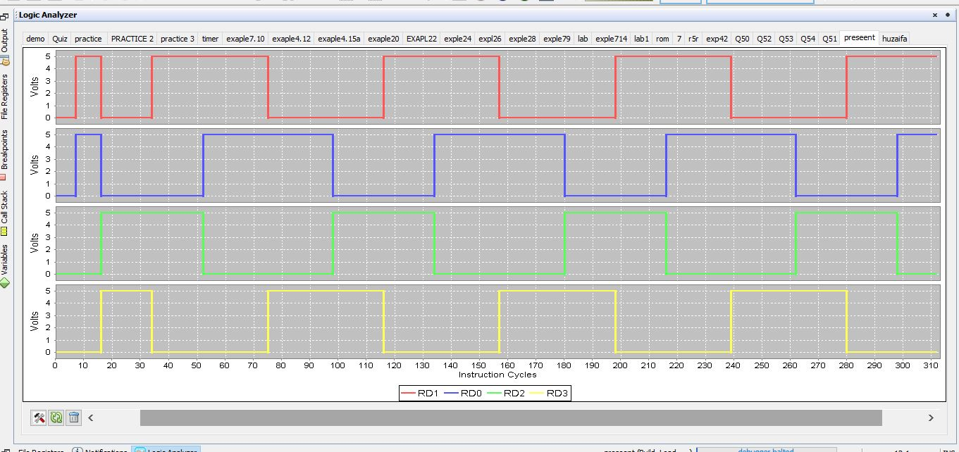
Presentation of PIC Microcontroller
Question: How to design a circuit using PIC Microcontroller to control the stepper motor?
history
history
output
teams
The end
follow
services
teams
timeline
timeline
about
about

Slide 13
Presentation of PIC Microcontroller
Thank You
Question: How to design a circuit using PIC Microcontroller to control the stepper motor?
THE END
The End

